Slide 1

Structure of DNA and its role as a cellular data storage device
Dr. Rocío Mercado
Department of Chemical Engineering, MIT
Interviewing for Assistant Professorship in Data-driven Cell and Molecular Biology
Wednesday January 12, 2022

Slide 2
Lecture aims
You will learn:
Structure of DNA
High level overview of how cells utilize DNA as a code
Examples of DNA in biotechnology

Slide 3
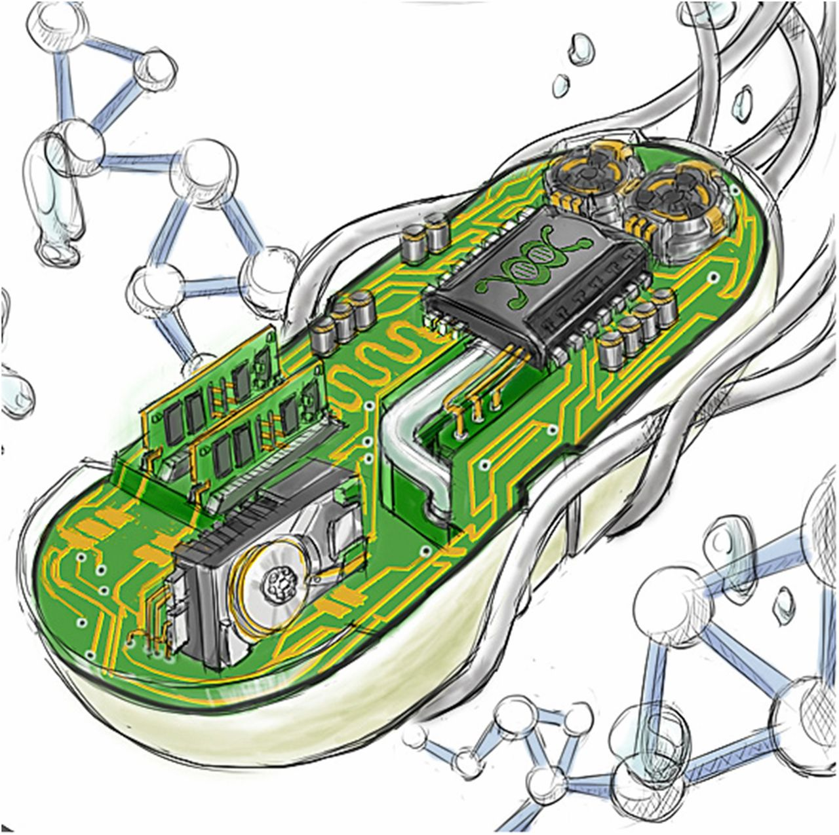
Figure:
Megan Scudellari. PNAS December 29, 2015 112 (52) 15771-15772; https://doi.org/10.1073/pnas.1520100112.

Slide 4
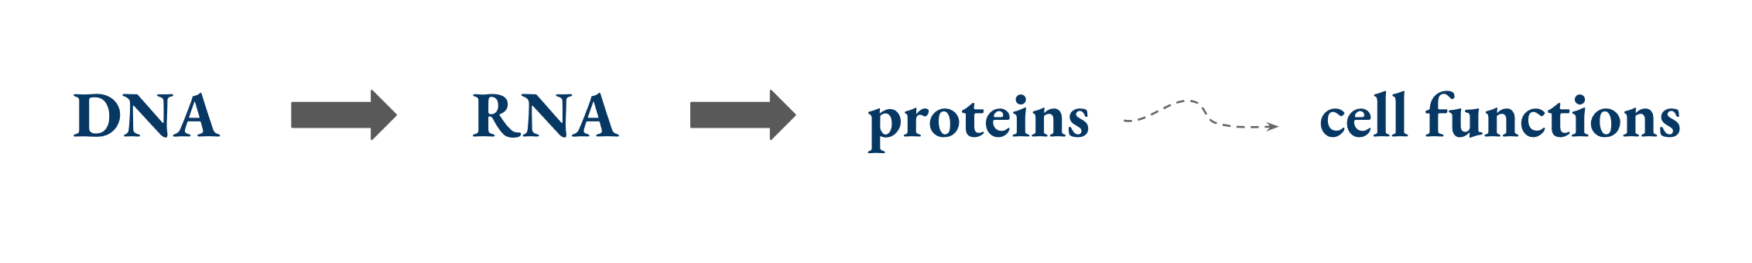
The central dogma of molecular biology
DNA contains all the information to make proteins
A simplified view of the central dogma.

Slide 5
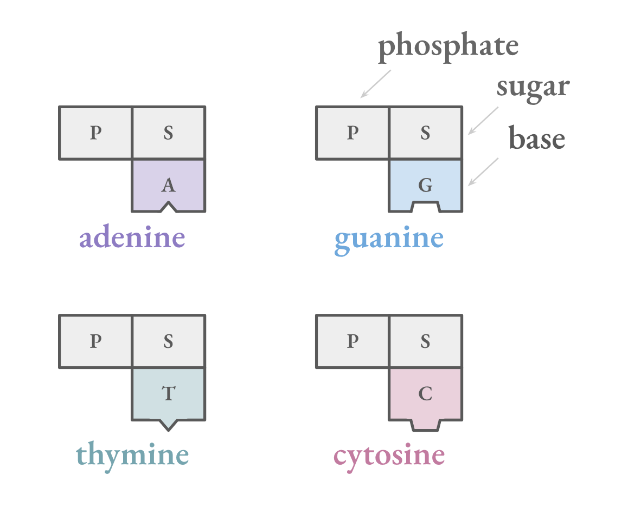
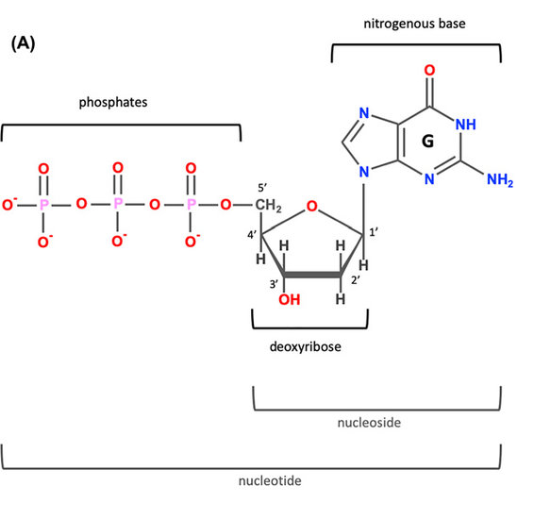
DNA molecules are made up of nucleotides
Figure:
Minchin, Steve & Lodge, Julia. Understanding biochemistry: structure and function of nucleic acids. Essays in biochemistry. 2019. 63. 433-456. 10.1042/EBC20180038.

Slide 6
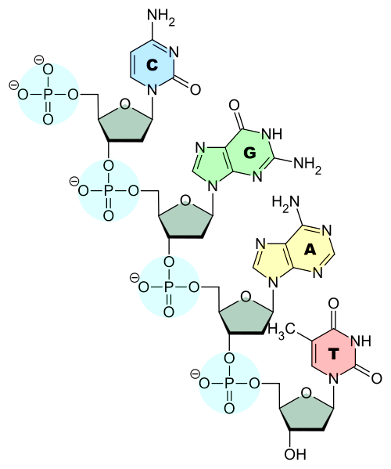
DNA molecules are made up of nucleotides
Figure:
https://en.m.wikipedia.org/wiki/File:DNA-Nucleobases.svg

Slide 7
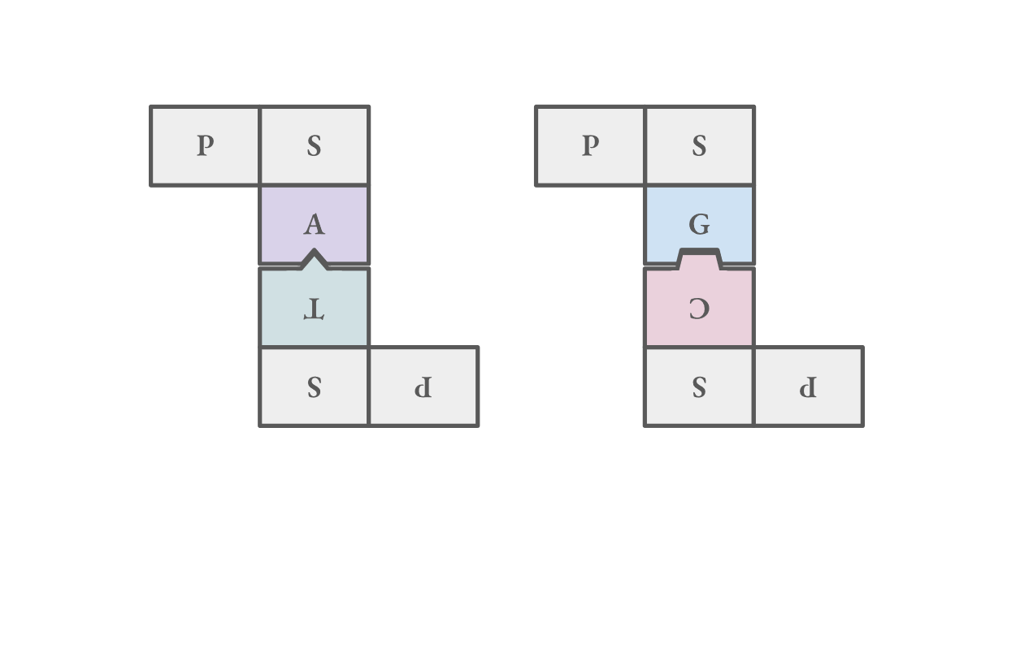
Nucleotides pair up ("base pair") and form double-stranded molecules

Slide 8
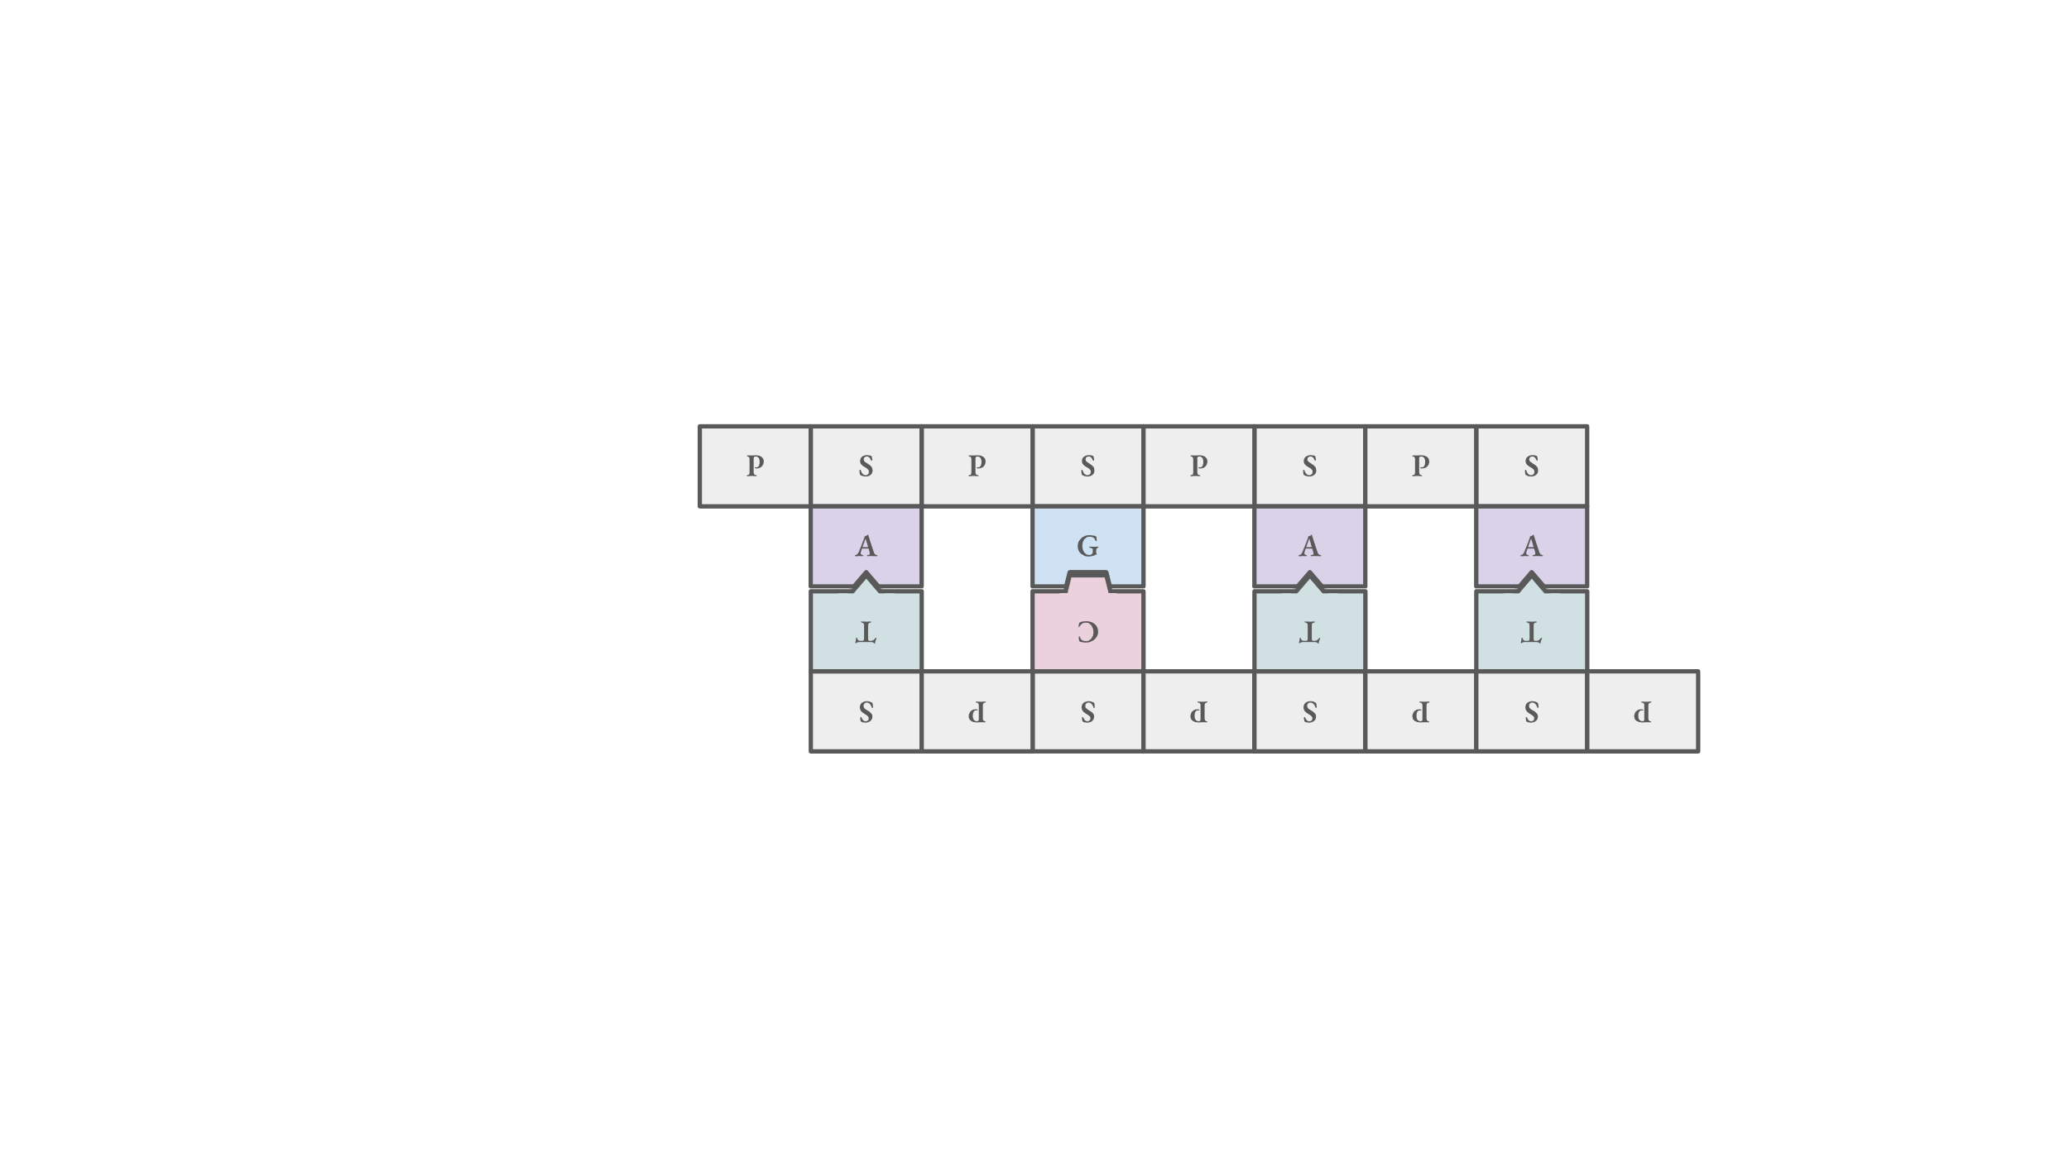
Nucleotides pair up ("base pair") and form double-stranded molecules
DNA backbone
base pairs

Slide 9
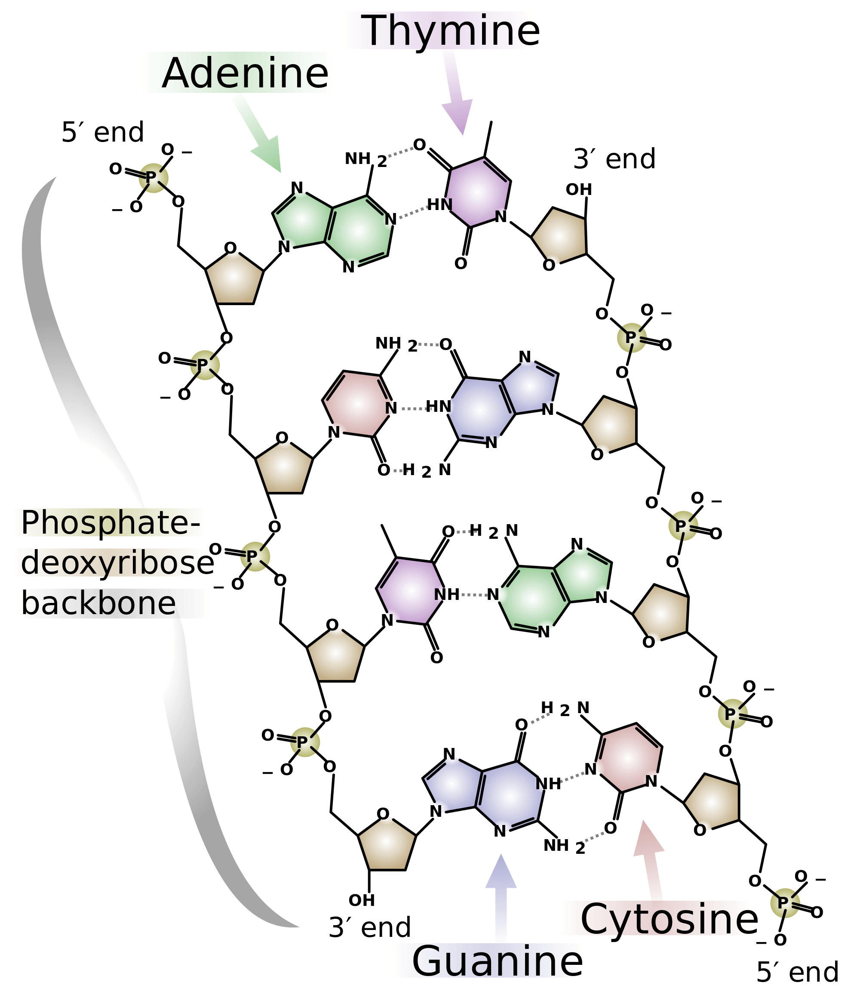
Nucleotides pair up ("base pair") and form double-stranded molecules
favorable
van der Waals
forces
A-T selectivity
G-C selectivity
Figure:
https://d20khd7ddkh5ls.cloudfront.net/dna_chemical_structure.svg.png

Slide 10
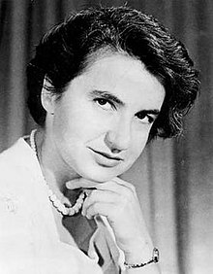
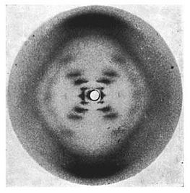
DNA forms a double helix structure
Rosalind Franklin
(1920 – 1958)
'photo 51'
led to discovery of the DNA double helix
F. Crick, J. Watson, M. Wilkins
Nobel Prize in Physiology or Medicine 1962
Figure:
RSCB Molecule of the Month – 'DNA' https://pdb101.rcsb.org/motm/23
https://en.wikipedia.org/wiki/File:Rosalind_Franklin_(1920-1958).jpg https://en.wikipedia.org/wiki/File:Photo_51_x-ray_diffraction_image.jpg
Figure:
RSCB Molecule of the Month – 'DNA' https://pdb101.rcsb.org/motm/23

Slide 11
DNA forms a double helix structure
factors contributing to double-helix structure:
electrostatic repulsion
between phosphates
-
-
-
-
P
P
P
P
Figure:
RSCB Molecule of the Month – 'DNA' https://pdb101.rcsb.org/motm/23

Slide 12
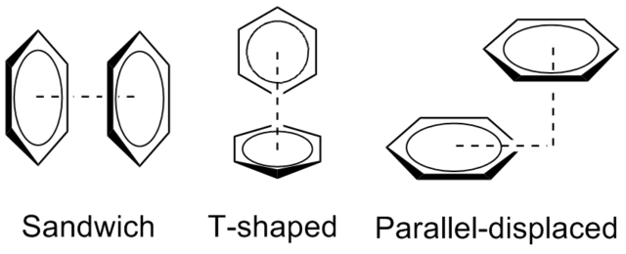
DNA forms a double helix structure
factors contributing to double-helix structure:
electrostatic repulsion
between phosphates
pi stacking
-
-
-
-
P
P
P
P
Figure:
RSCB Molecule of the Month – 'DNA' https://pdb101.rcsb.org/motm/23
https://upload.wikimedia.org/wikipedia/commons/thumb/3/3d/BenzeneDimerGeometries.png/640px-BenzeneDimerGeometries.png
Figure:
RSCB Molecule of the Month – 'DNA' https://pdb101.rcsb.org/motm/23

Slide 13
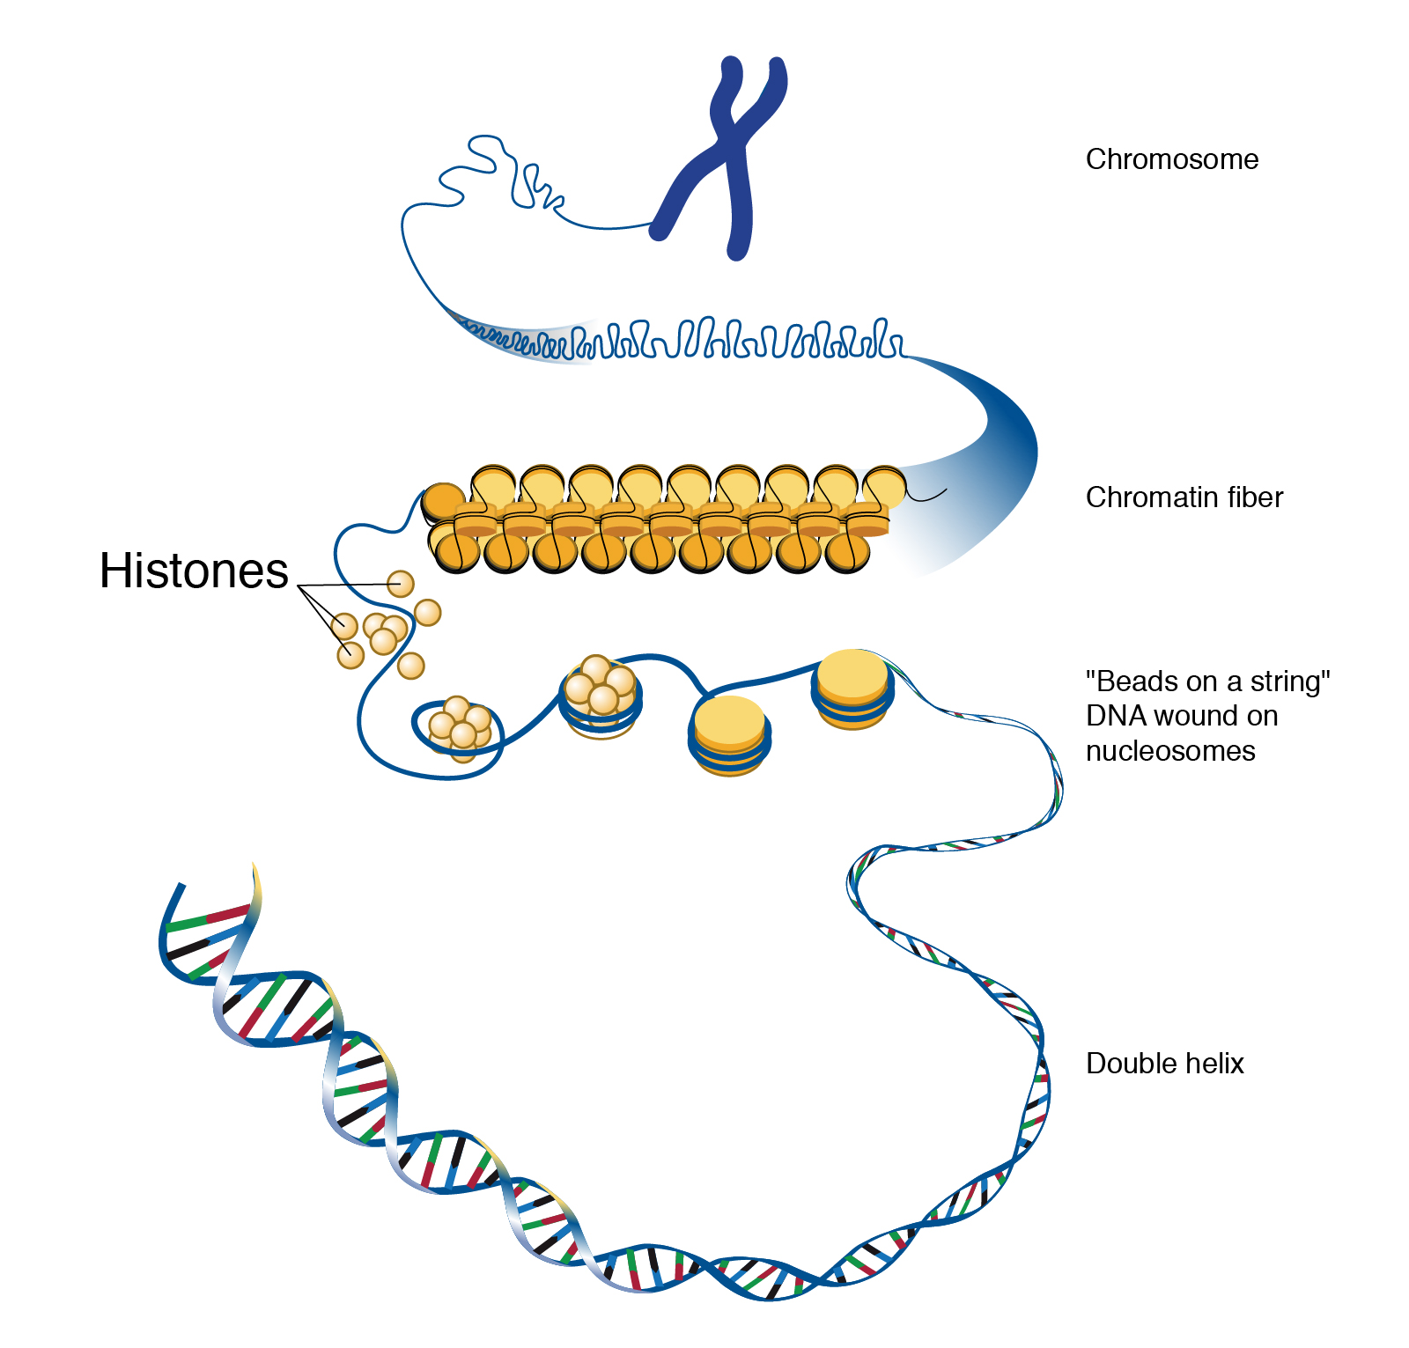
DNA is organized into chromosomes
20 Å
in humans:
~2 m
Figures:
https://www.genome.gov/genetics-glossary/histone

Slide 14
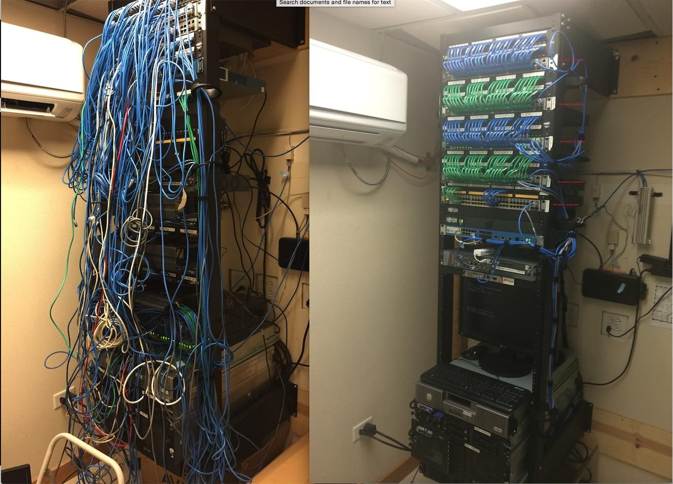
DNA is organized into chromosomes
Figures:
https://www.genome.gov/genetics-glossary/histone
https://i.pinimg.com/originals/19/f8/bd/19f8bd9fa89db3cef55028e07c49b4d3.jpg

Slide 15
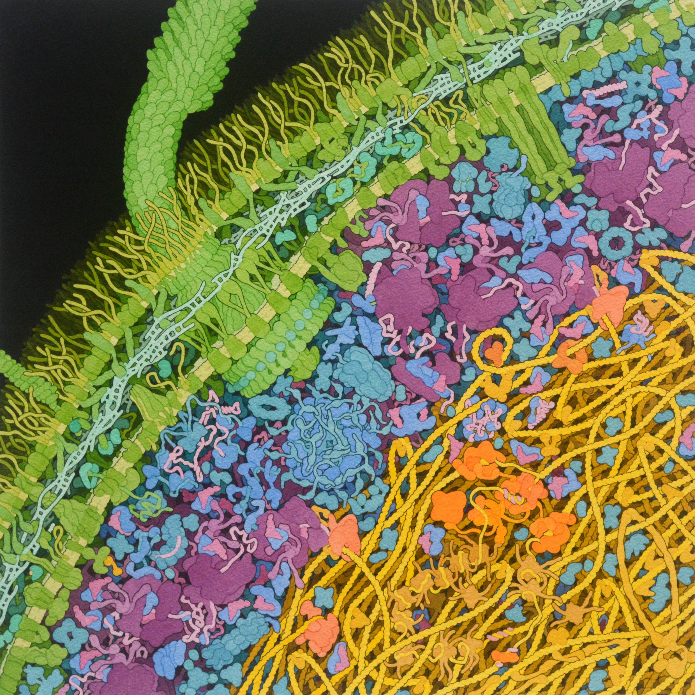
Figure:
Illustration by David S. Goodsell, RCSB Protein Data Bank. doi: 10.2210/rcsb_pdb/goodsell-gallery-028

Slide 16
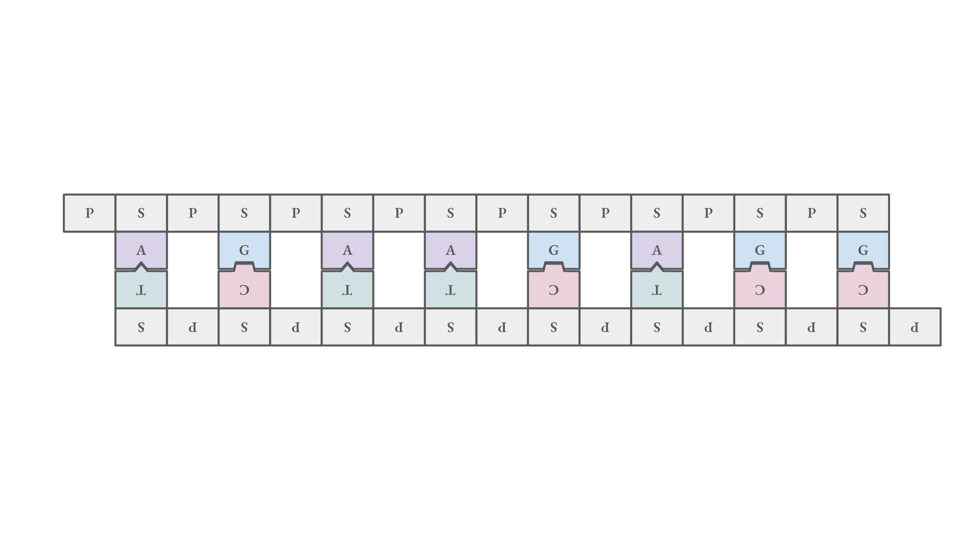
Genes in DNA encode for proteins
'non-coding DNA'
gene
'non-coding DNA'
codes for
protein
Figure:
RSCB Molecule of the Month – 'Golgi Casein Kinase' https://pdb101.rcsb.org/motm/265

Slide 17
Translating DNA code into amino acid sequences
TCT
CCG
GAG
AAG
codon 4
codon 1
codon 3
codon 2
codon: a tri-nucleotide sequence of DNA

Slide 18
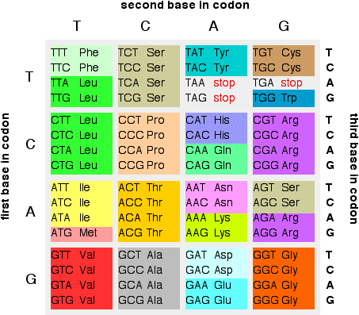
Translating DNA code into amino acid sequences
DNA codon table
TCT
CCG
GAG
AAG
Ser
Pro
Glu
Lys
amino acid sequence
2D → 3D (folding)
protein
(codon → amino acid)
Figure:
https://www.chemguide.co.uk/organicprops/aminoacids/dnacode.gif

Slide 19
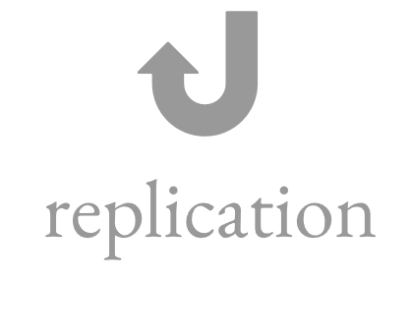
The central dogma of molecular biology
DNA contains all the information to make proteins
DNA replication: the process by which DNA makes a copy of itself during cell division
A simplified view of the central dogma.

Slide 20
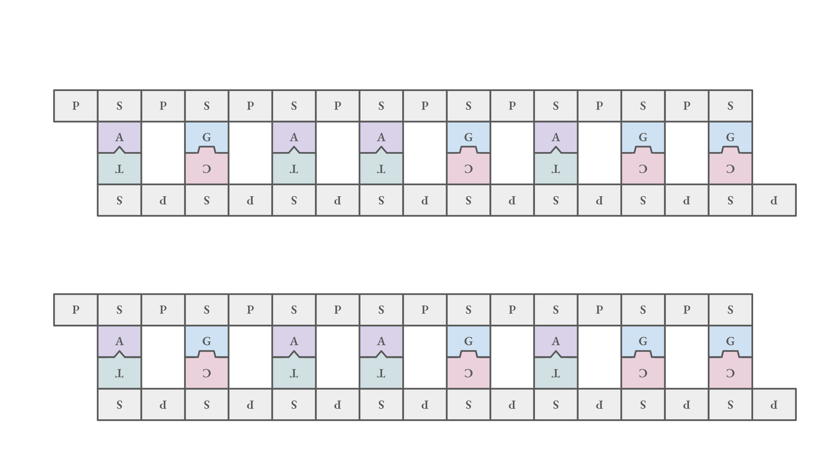
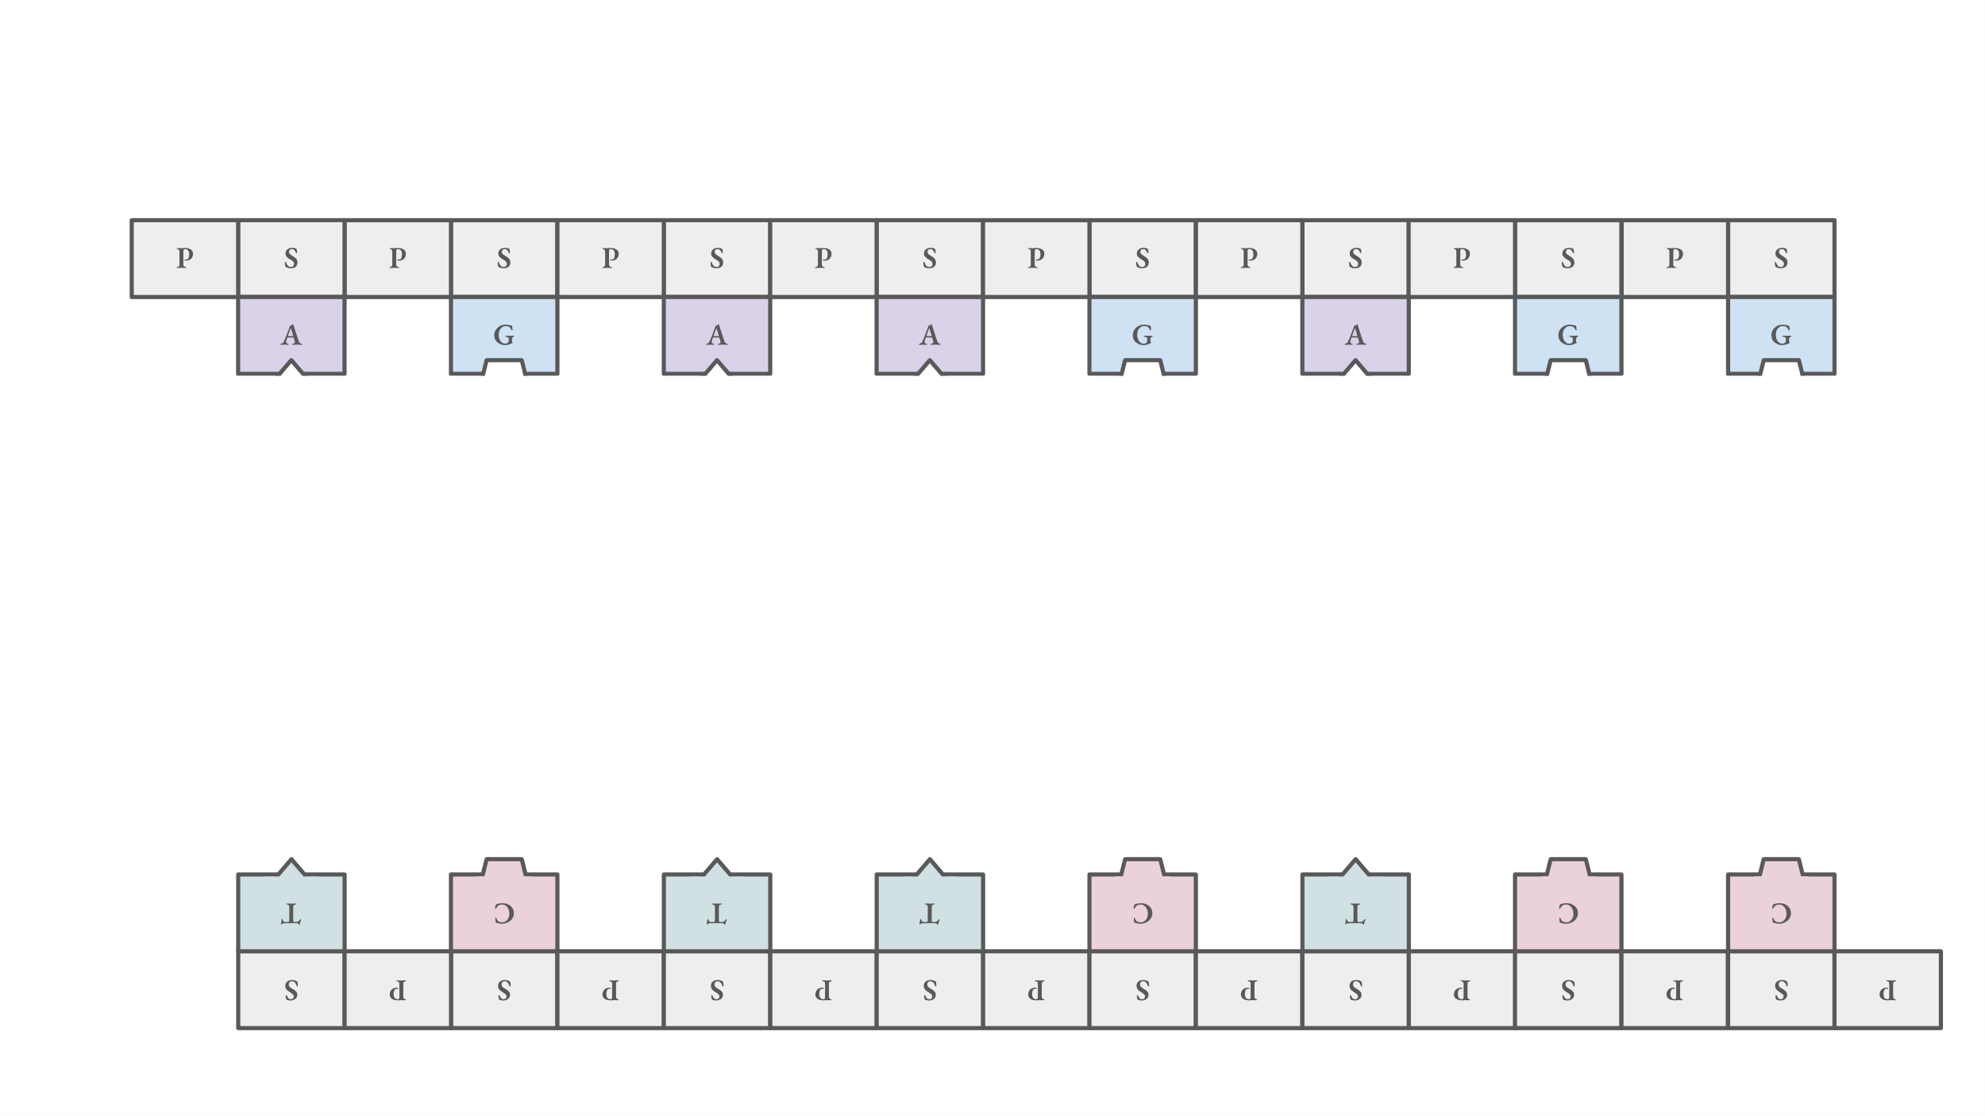
DNA can be replicated
complementary strands → templates for two identical copies of DNA
complementary strands
A simplified illustration of DNA replication.

Slide 21
DNA as a cellular storage device
DNA contains all the information to make proteins
DNA contains the "code" to make proteins (storage)
We can read and write the code
We can also proofread the code (error correcting)
the 'executable'
A simplified view of the central dogma.

Slide 22
Figure:
Megan Scudellari. PNAS December 29, 2015 112 (52) 15771-15772; https://doi.org/10.1073/pnas.1520100112.

Slide 23

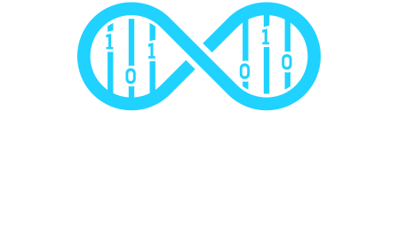






(Just a few) examples of DNA in biotechnology
DNA storage:
Gene editing:
DNA computing:
King Lab
DNA storage:
https://www.catalogdna.com/
https://www.genscript.com/application-of-synthetic-biology-in-data-storage.html
https://www.twistbioscience.com/products/storage
https://www.microsoft.com/en-us/research/project/dna-storage/
DNA computing:
https://www.sysbio.se/labs/king-lab/
Gene editing:
https://mammoth.bio/
https://www.editasmedicine.com/
http://www.crisprtx.com/

